Slide 1

7th Grade Math
Unit 10, Lesson 9 Writing Two-Step Equations from Real-World Contexts Volume 2, pg. 134

Slide 2


Benchmark
MA.7.AR.2.2
Write and solve two-step equations in one variable within a mathematical context or real-world context, where all terms are rational numbers.
volume 2, pg. 134

Slide 3
Integrated Mathematical Thinking and Reasoning Standards
MA.K12.MTR.1.1 Actively participate in effortful learning both individually and collectively.
MA.K12.MTR.3.1 Complete tasks with mathematical fluency.
MA.K12.MTR.4.1 Engage in discussions that reflect on the mathematical thinking of self and others.
MA.K12.MTR.5.1 Use patterns and structure to help understand and connect mathematical concepts.
MA.K12.MTR.6.1 Assess the reasonableness of solutions.
MA.K12.MTR.7.1 Apply mathematics to real-world contexts.
volume 2, pg. 134

Slide 4

Learning Targets
I can write two-step equations to represent real-world contexts.
I can solve two-step equations within a real-world context.
volume 2, pg. 134

Slide 5

Warm-Up
volume 2, pg. 135

Slide 6
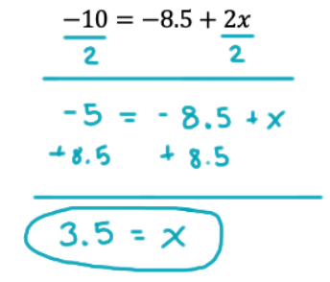
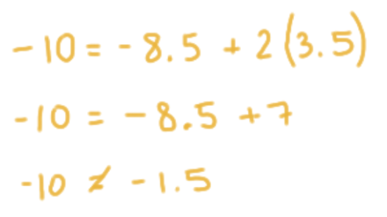
10.9.1 Warm-Up: Bell Work
Tremaine solved the equation $−10=−8.5+2x$ and checked his solution. His work and check are shown.
Work | Check
volume 2, pg. 135

Slide 7
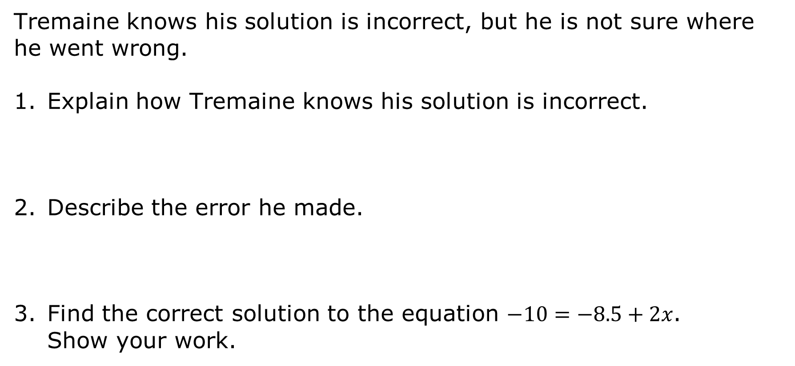
Tremaine knows his solution is incorrect, but he is not sure where he went wrong.
Explain how Tremaine knows his solution is incorrect.
Describe the error he made.
Find the correct solution to the equation $−10=−8.5+2x$. Show your work.
volume 2, pg. 135

Slide 8

Guided Instruction
volume 2, pg. 135

Slide 9
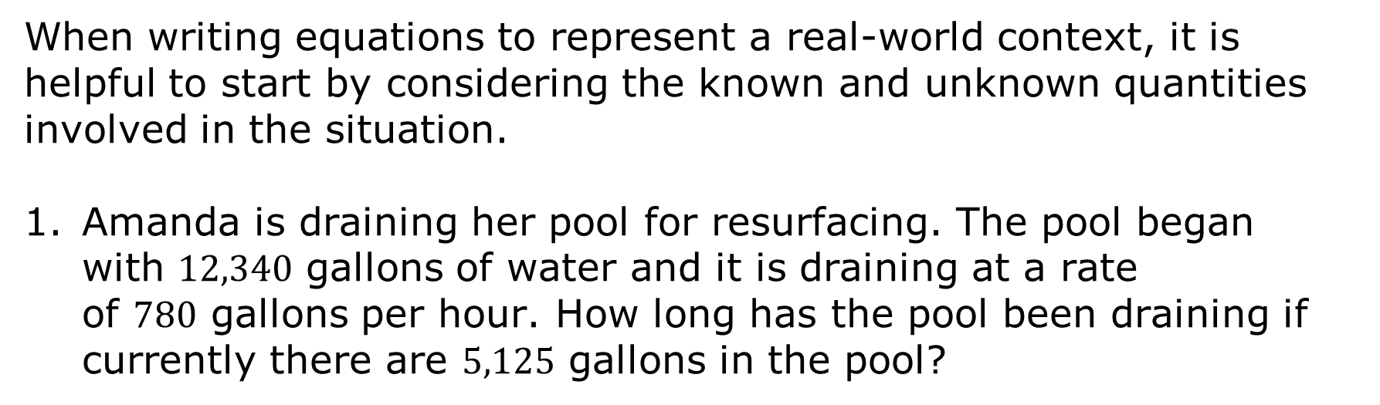
10.9.2 Guided Instruction: Writing Two-Step Equations from Real-World Contexts
When writing equations to represent a real-world context, it is helpful to start by considering the known and unknown quantities involved in the situation.
Amanda is draining her pool for resurfacing. The pool began with $12,340$ gallons of water and it is draining at a rate of $780$ gallons per hour. How long has the pool been draining if currently there are $5,125$ gallons in the pool?
volume 2, pg. 135

Slide 10
Complete the table to describe the known and unknown quantities in this situation.
Known Quantities | Unknown Quantities
volume 2, pg. 135

Slide 11

With your partner, discuss how the quantities are related in this situation.
When writing equations to represent real-world contexts, any variables used must be defined to identify which quantity each variable in the equation represents.
volume 2, pg. 135

Slide 12
Define the unknown quantity using a variable.
Write an equation that could be used to find the unknown quantity using the variable you defined.
volume 2, pg. 136

Slide 13
Solve the equation.
Explain what the solution means in this context.
volume 2, pg. 136

Slide 14
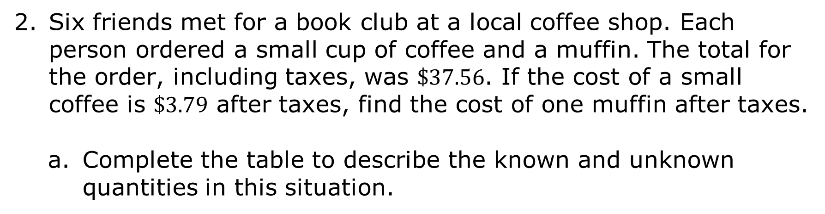
Six friends met for a book club at a local coffee shop. Each person ordered a small cup of coffee and a muffin. The total for the order, including taxes, was $\$37.56$. If the cost of a small coffee is $\$3.79$ after taxes, find the cost of one muffin after taxes.
Complete the table to describe the known and unknown quantities in this situation.
Known Quantities | Unknown Quantities
volume 2, pg. 136

Slide 15
Define the unknown quantity using a variable.
Write an equation that could be used to find the unknown quantity using the variable defined.
volume 2, pg. 136

Slide 16
Solve the equation.
Explain what the solution means in this context.
volume 2, pg. 137

Slide 17

Try It
volume 2, pg. 137

Slide 18
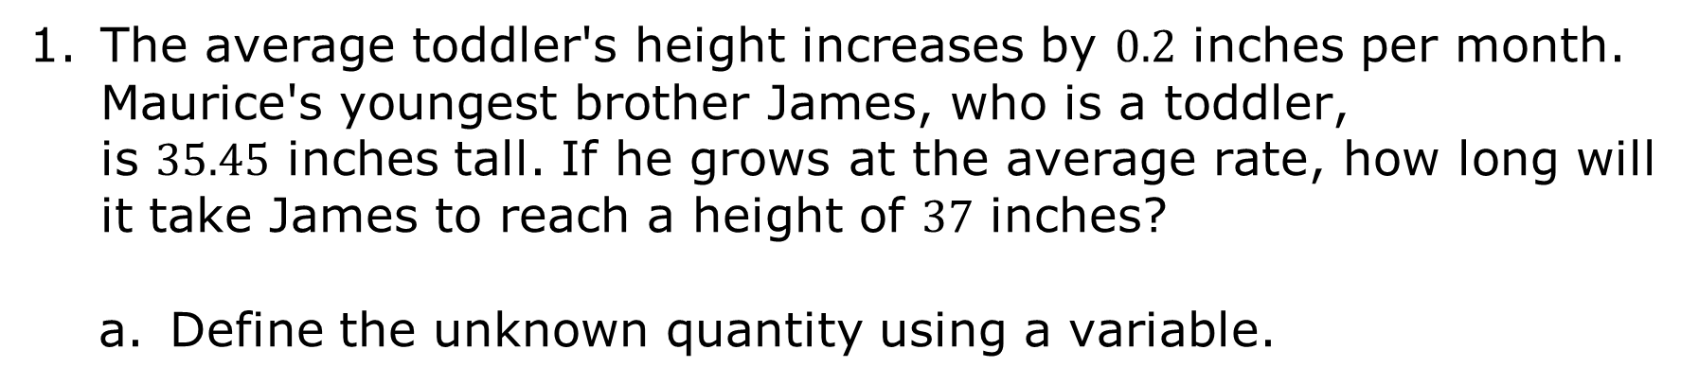
10.9.3 Try It: Writing Two-Step Equations from Real-World Contexts
The average toddler's height increases by $0.2$ inches per month. Maurice's youngest brother James, who is a toddler, is $35.45$ inches tall. If he grows at the average rate, how long will it take James to reach a height of $37$ inches?
Define the unknown quantity using a variable.
volume 2, pg. 137

Slide 19
Write an equation that could be used to find the unknown quantity using the variable defined.
Solve the equation.
Explain what the solution means in this context.
volume 2, pg. 137

Slide 20

Guided Practice
volume 2, pg. 138

Slide 21
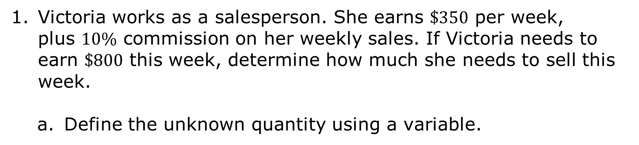
10.9.4 Guided Practice: Writing Two-Step Equations from Real-World Contexts Involving Percentages
Victoria works as a salesperson. She earns $\$350$ per week, plus $10\%$ commission on her weekly sales. If Victoria needs to earn $\$800$ this week, determine how much she needs to sell this week.
Define the unknown quantity using a variable.
volume 2, pg. 138

Slide 22
Write an equation that could be used to find the unknown quantity using the variable defined.
Solve the equation.
Explain what the solution means in this context.
volume 2, pg. 138

Slide 23
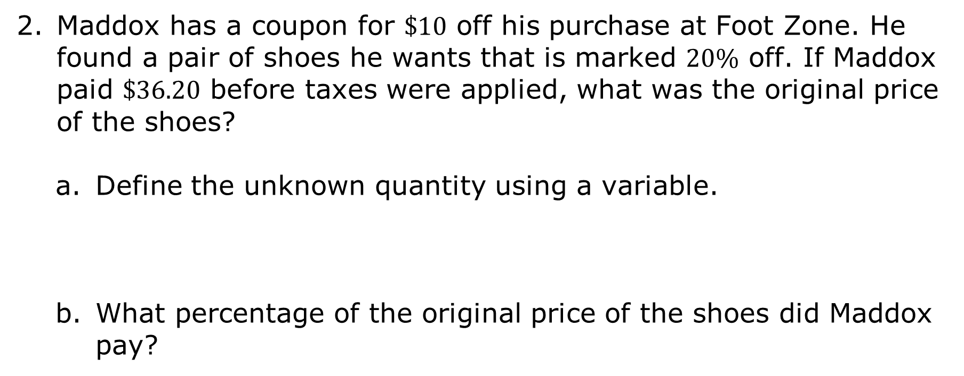
Maddox has a coupon for $\$10$ off his purchase at Foot Zone. He found a pair of shoes he wants that is marked $20\%$ off. If Maddox paid $\$36.20$ before taxes were applied, what was the original price of the shoes?
Define the unknown quantity using a variable.
What percentage of the original price of the shoes did Maddox pay?
volume 2, pg. 138

Slide 24
Write an equation that can be used to find the unknown quantity using the variable defined.
Solve the equation.
Explain what the solution means in this context.
volume 2, pg. 138

Slide 25

Wrap-Up
volume 2, pg. 139

Slide 26
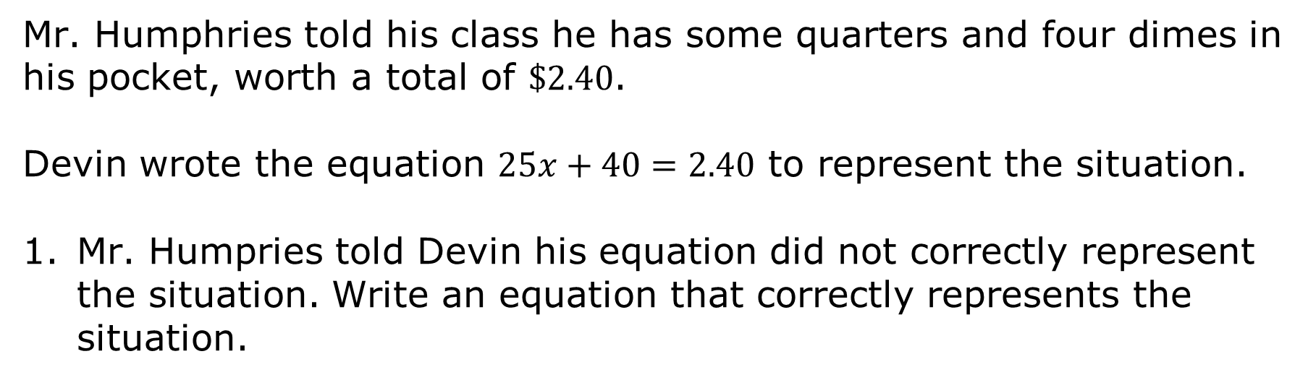
10.9.5 Wrap-Up: Error Analysis
Mr. Humphries told his class he has some quarters and four dimes in his pocket, worth a total of $\$2.40$.
Devin wrote the equation $25x+40=2.40$ to represent the situation.
Mr. Humpries told Devin his equation did not correctly represent the situation. Write an equation that correctly represents the situation.
volume 2, pg. 139

Slide 27
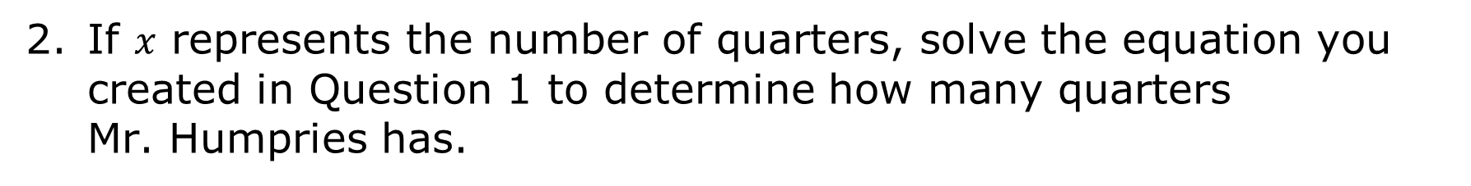
If $x$ represents the number of quarters, solve the equation you created in Question 1 to determine how many quarters Mr. Humpries has.
volume 2, pg. 139

